Slide 1

Dice Poker
Tomasz Leszczyński, Rafał Milczarski & Arkadiusz Kowalczyk

Slide 2
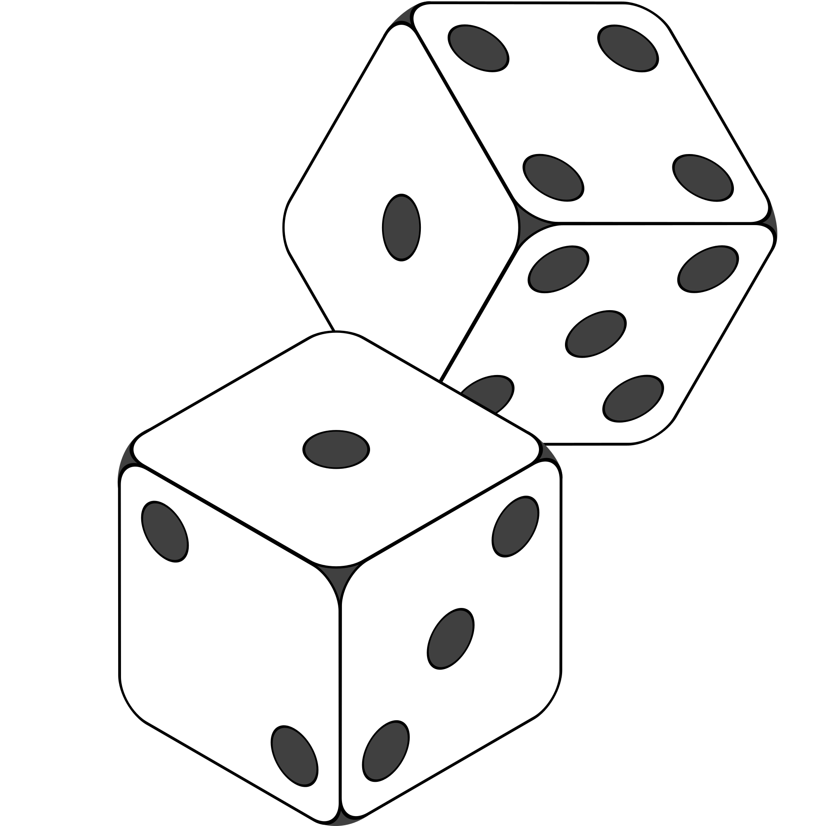
What's new?
PvAI mode
Exporting names with scores to external file
Added help files containing rules of the game and list of possible figures

Slide 3
How our work looked like?

Slide 4
Well....

Slide 5
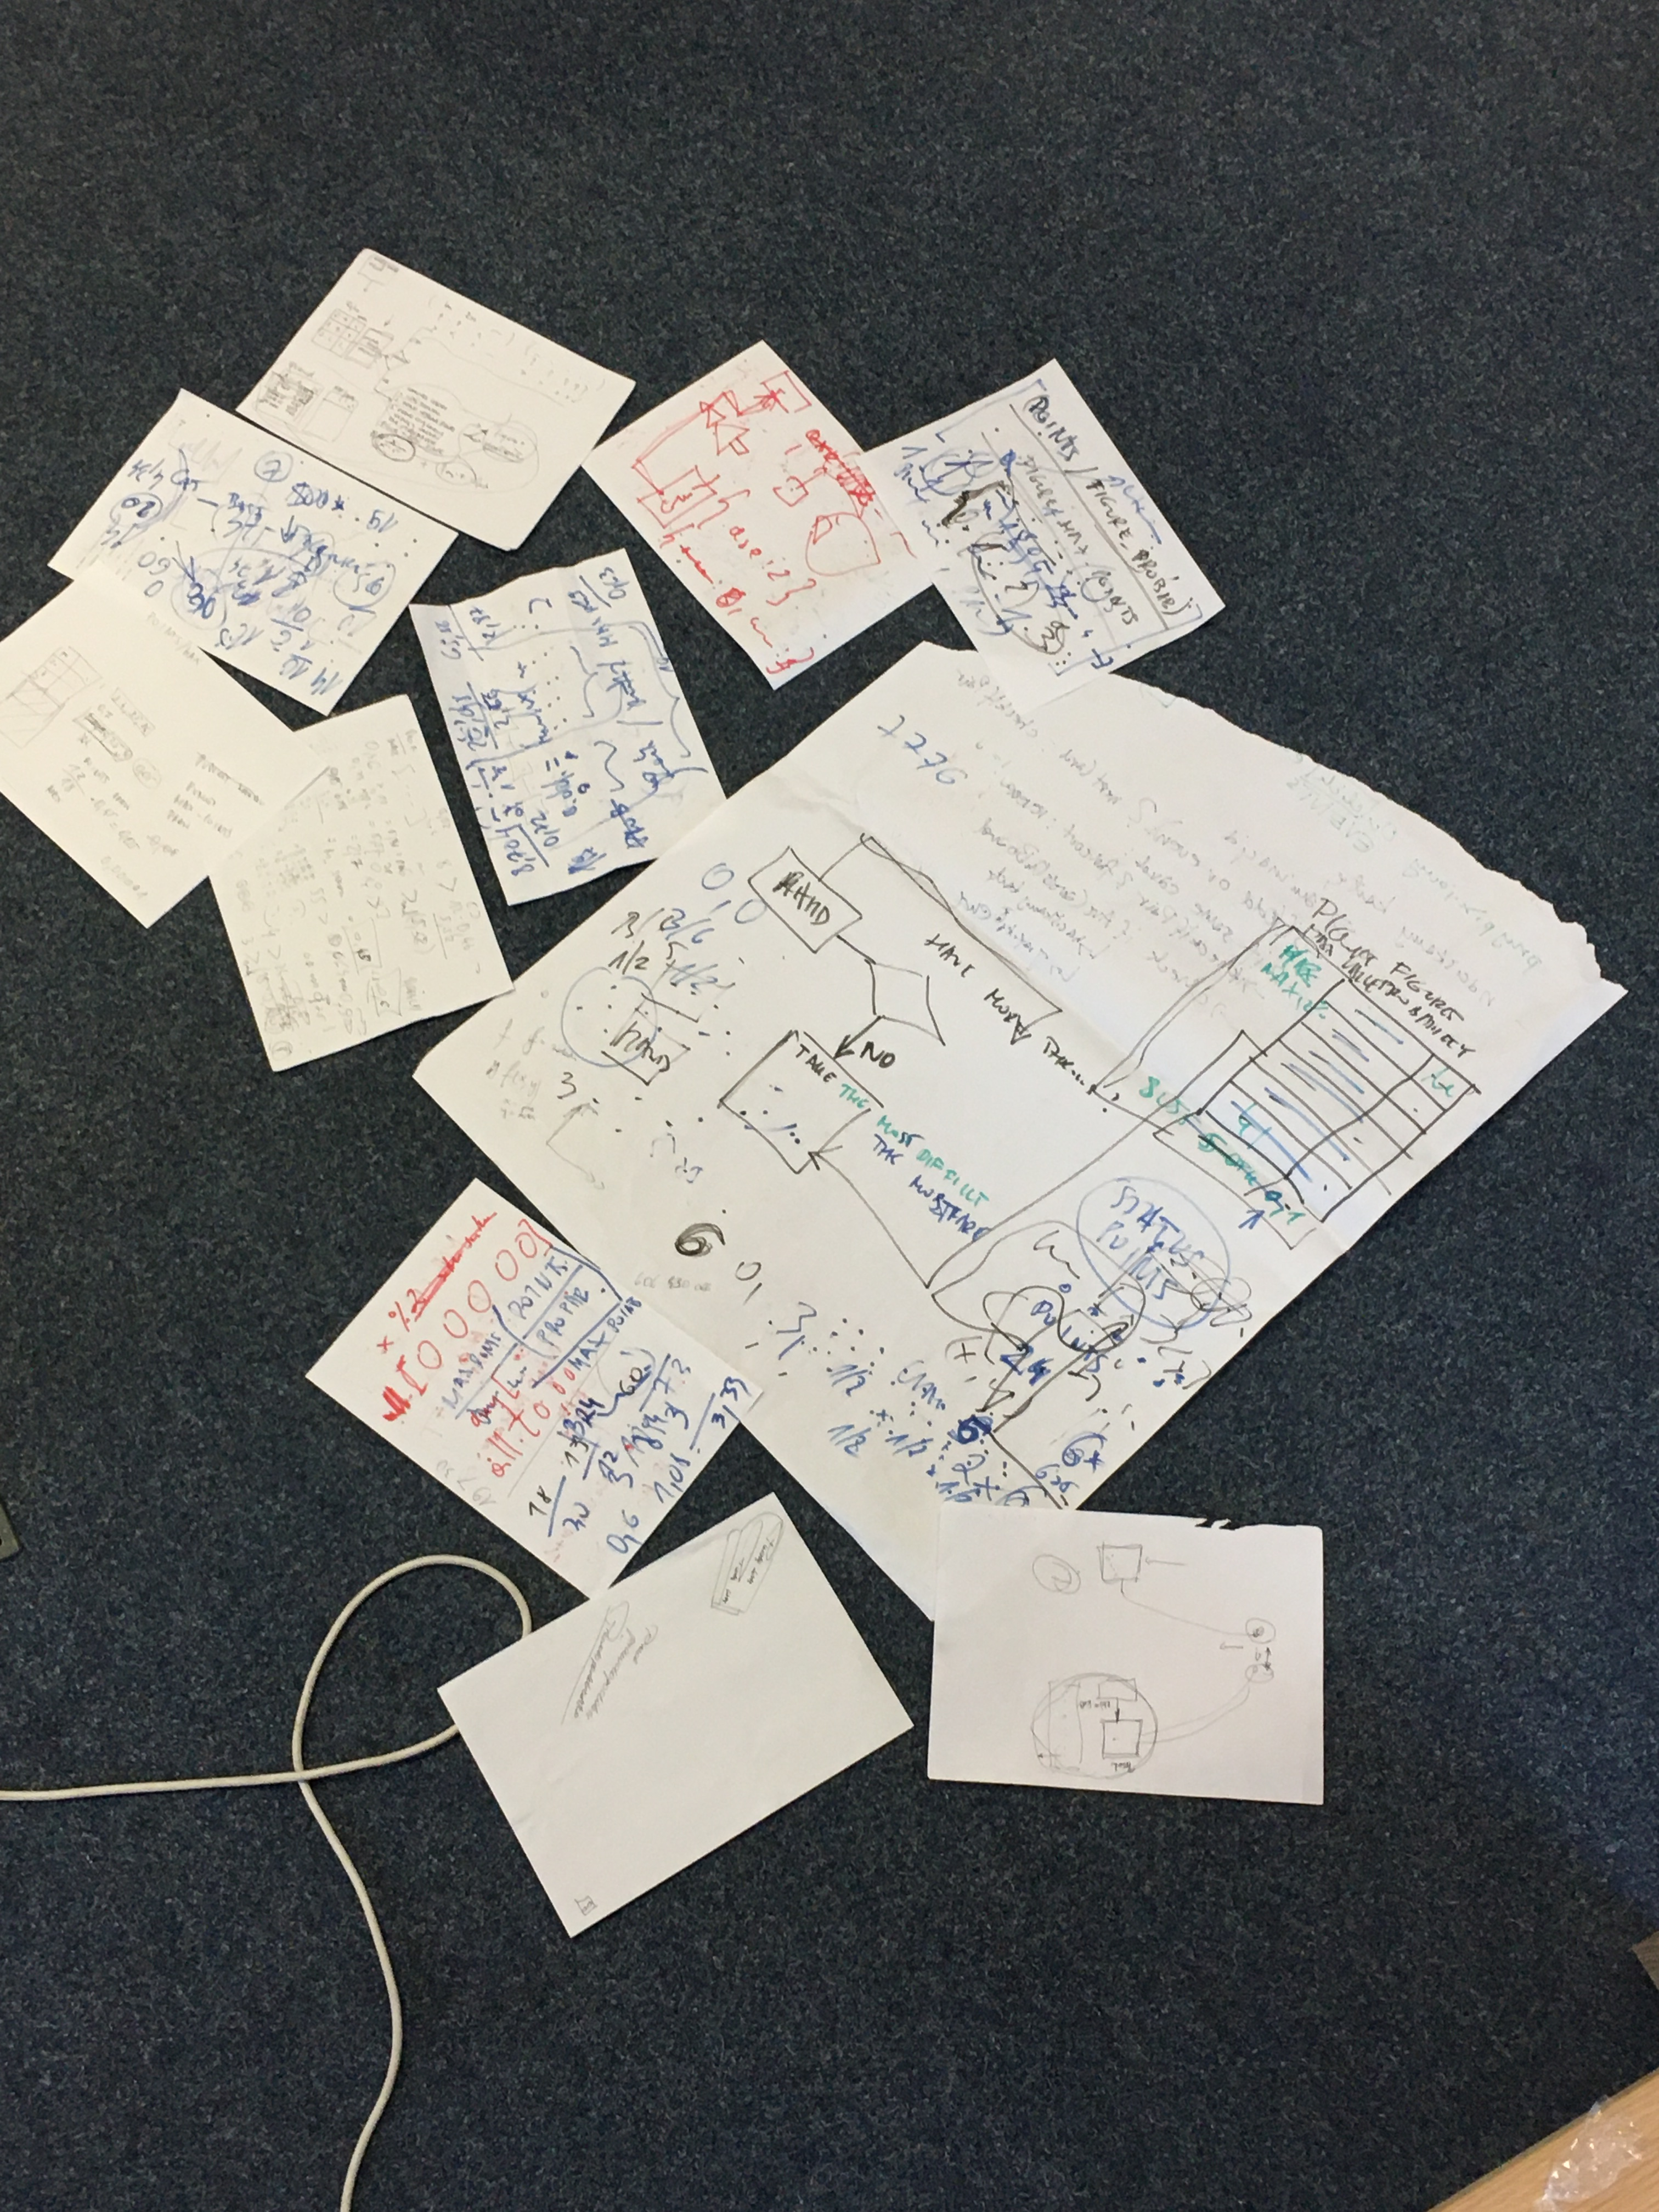
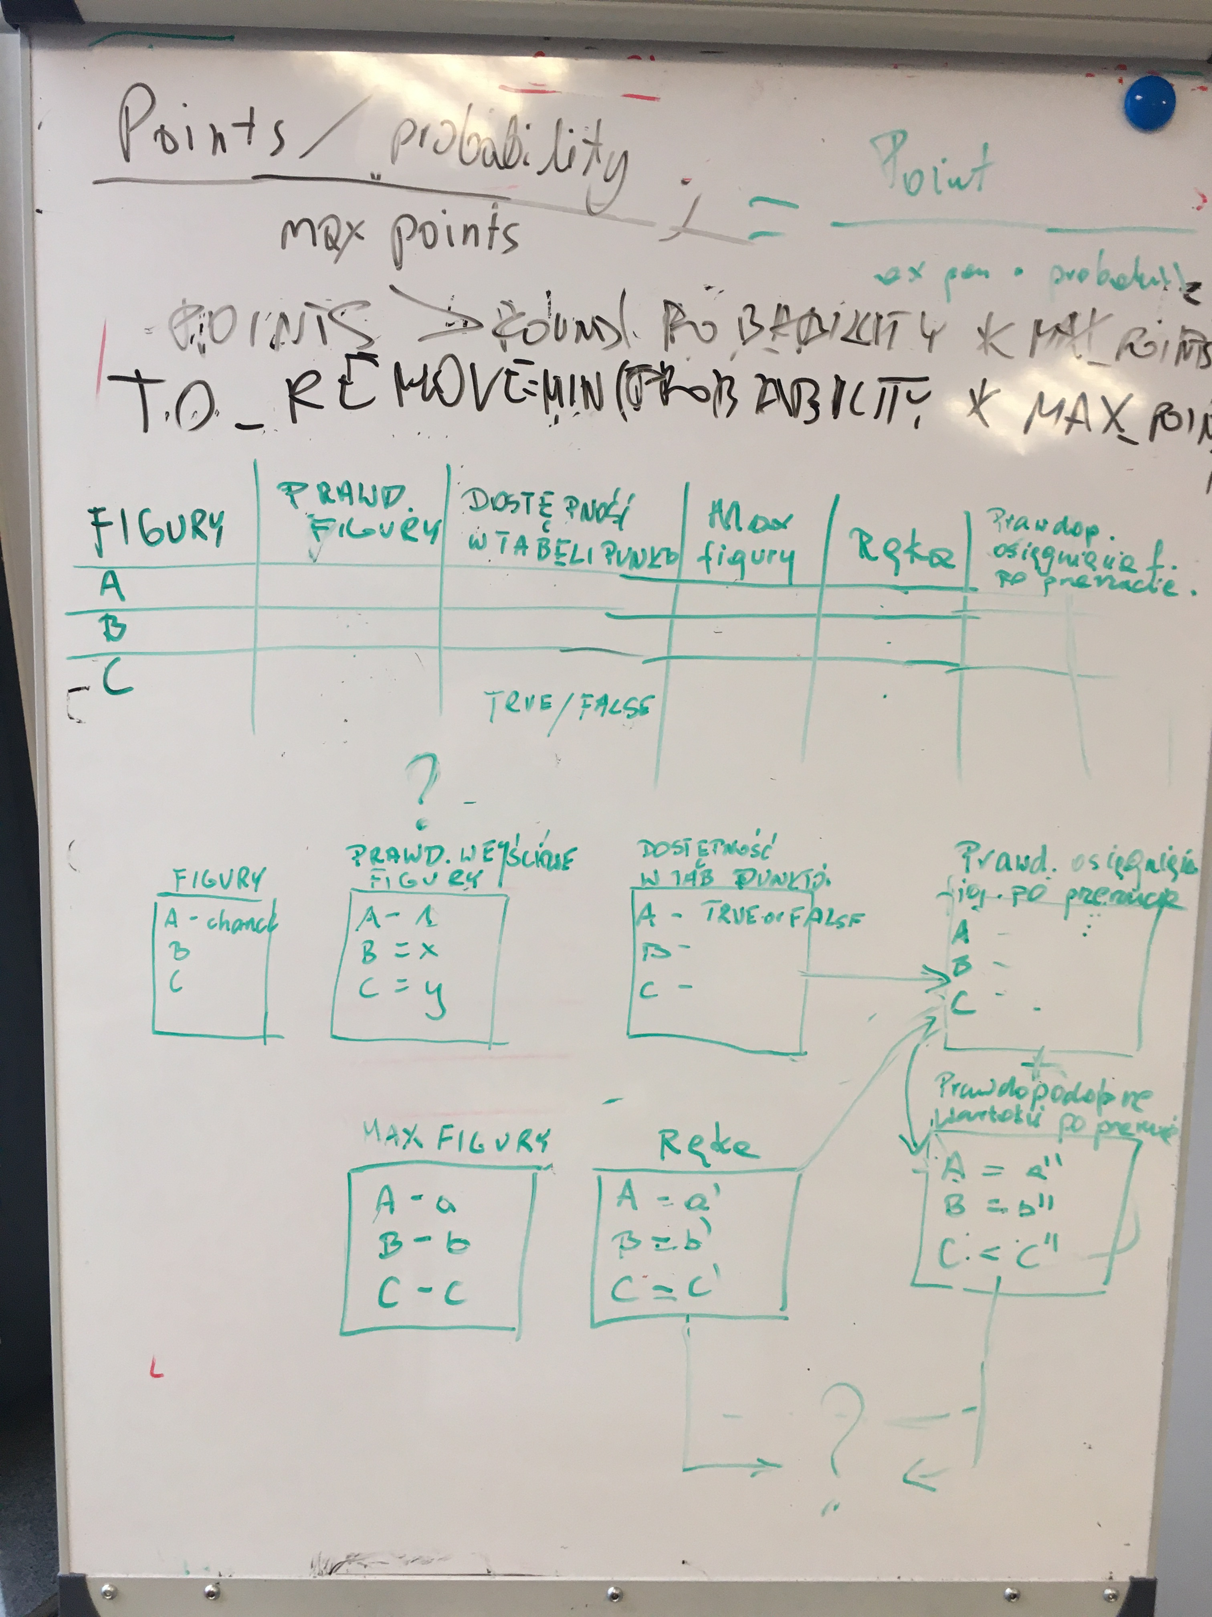

Slide 6



Tools

Slide 7
Artificial Intelligence in Dice Poker
Figure weight = figure probability * max points
Coefficient = (points / probability) / max points

Slide 8
Flowchart - Game logic

Slide 9
Flowchart - Game logic

Slide 10
Flowchart - Game logic

Slide 11
OUR GITHUBS AND CONTACT
Tomasz Leszczyński - tomaszleszczynski1980, lin.fowen@gmail.com
Rafał Milczarski – Ramilcz, ramilcz@gmail.com
Arkadiusz Kowalczyk - arkadiuszkowalczyk061, akowalczyk061@gmail.com

